Slide 1



Robotus
Digital Multi
Meter
1

Slide 2
Table of contents
01
02
03
04
05
Introduction
Design
Programming
06
Test & Result
PCB
Implementation
Conclusion & future work
2

Slide 3

01
Introduction
3

Slide 4
Motivation
01
Circuit Analysis
Educational
Field
Repairing and Debug
4

Slide 5
02
Design
5

Slide 6
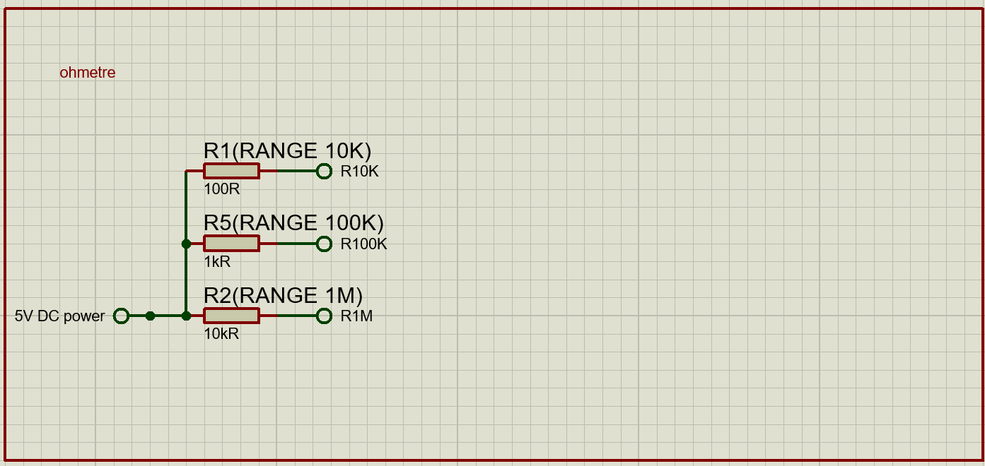
Ohmmeter
02
6

Slide 7
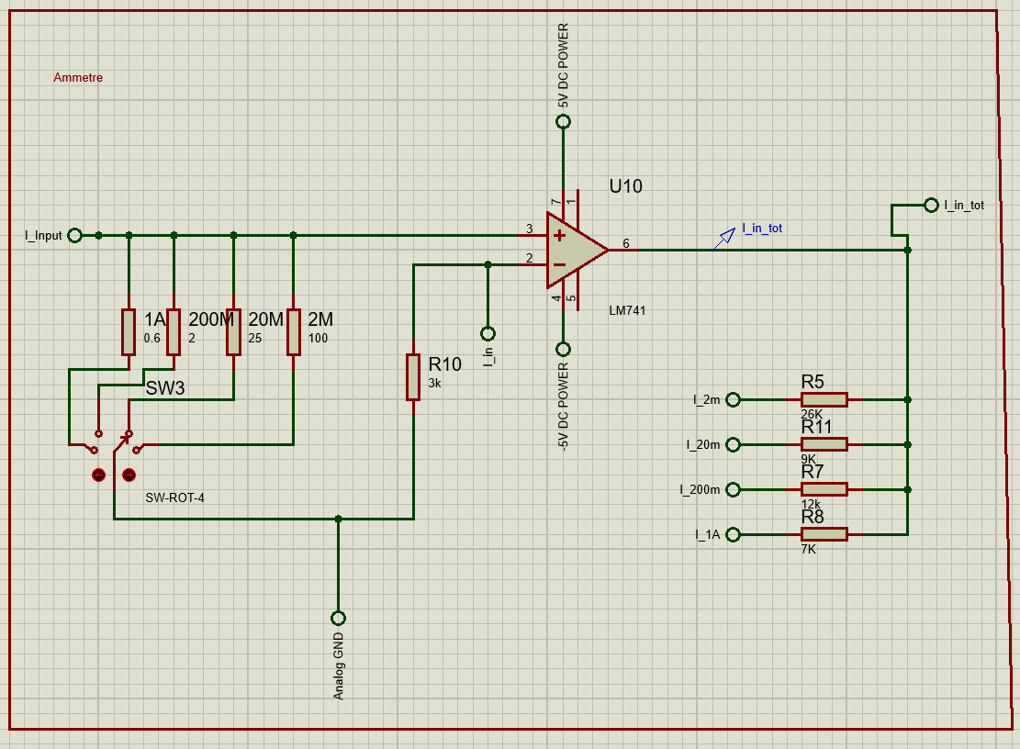
Ammeter
02
7

Slide 8
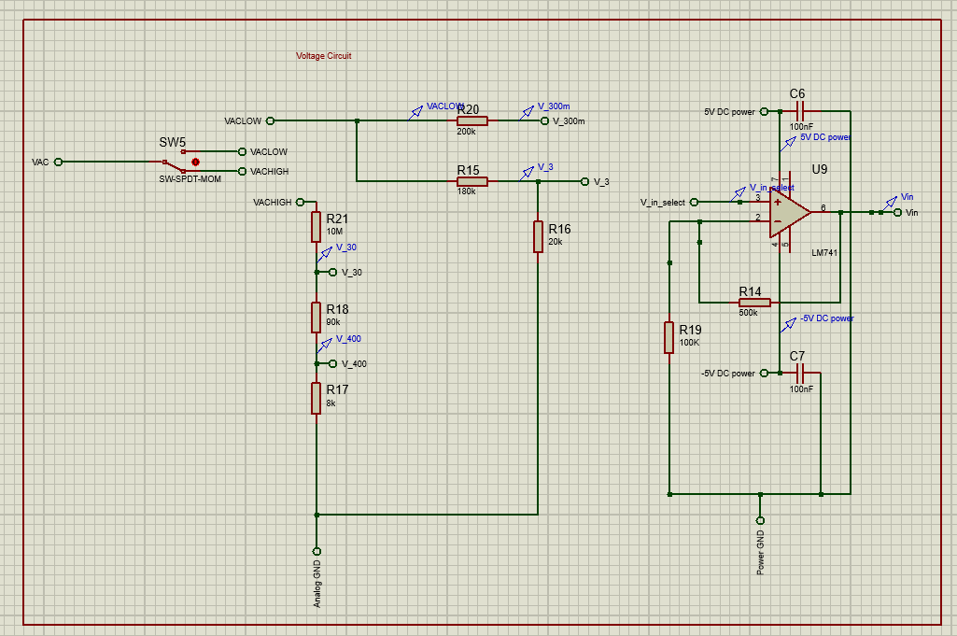
Voltmeter
02
8

Slide 9
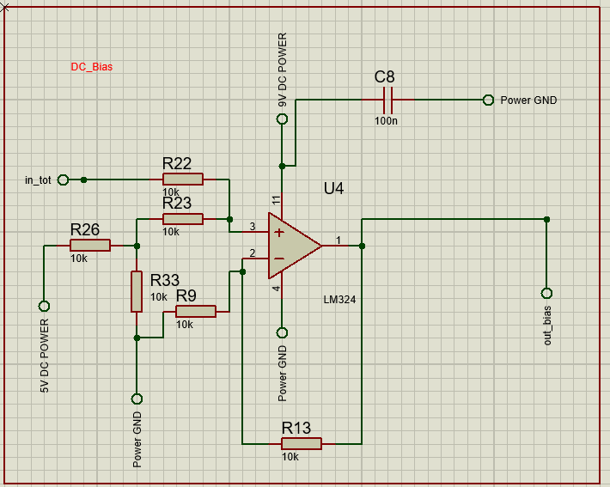
DC Bias
02
9

Slide 10
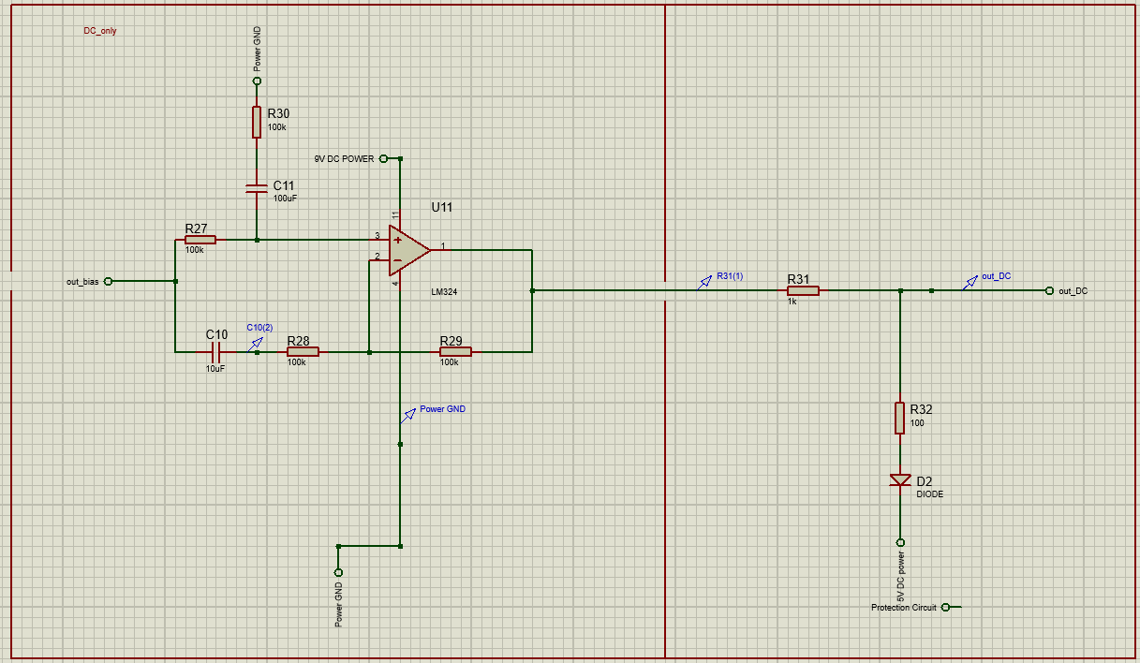
DC out
02
10

Slide 11
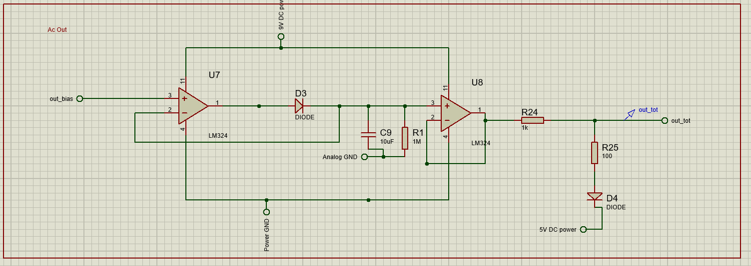
AC out
02
11

Slide 12
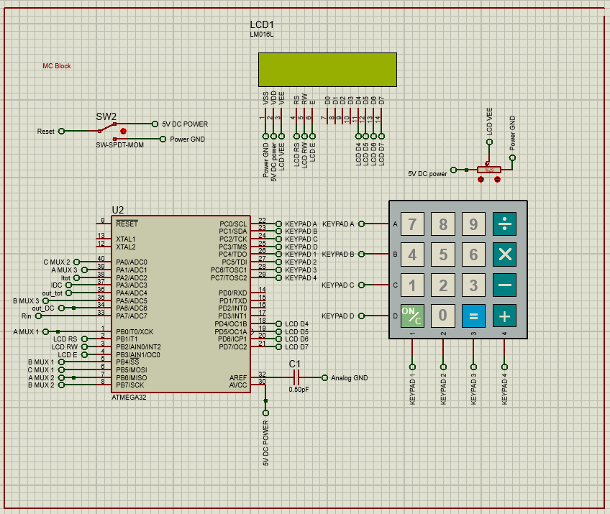
MC
02
12

Slide 13
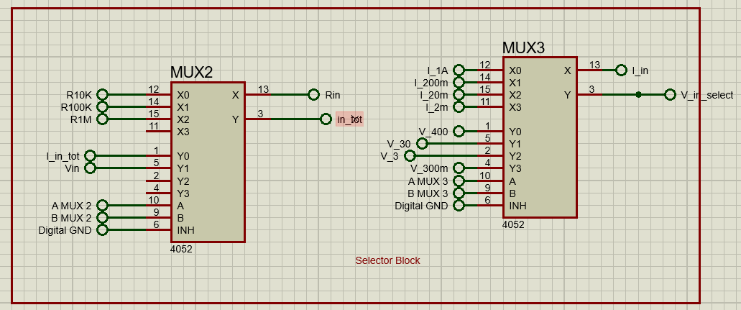
Selector
02
13

Slide 14
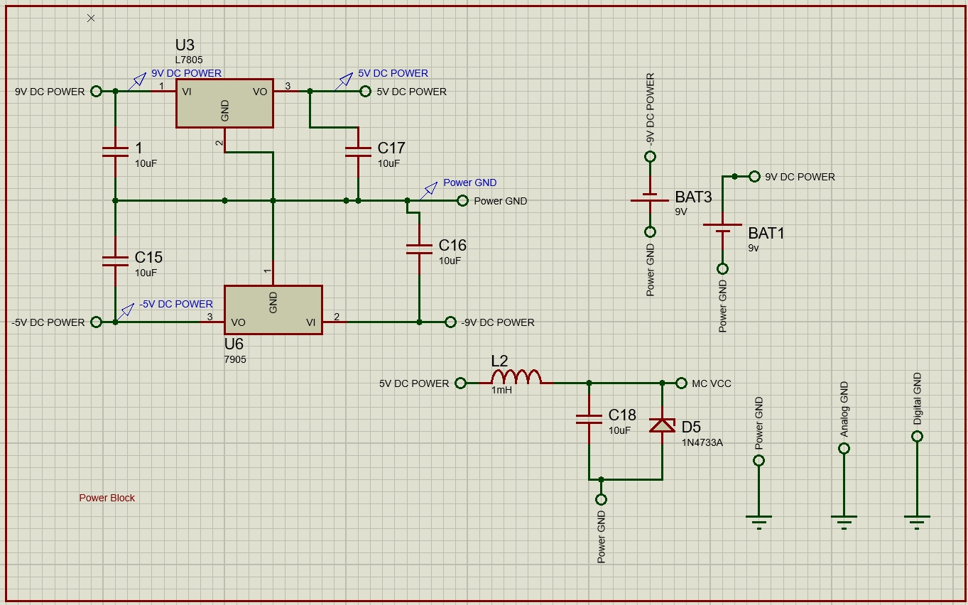
Power
02
14

Slide 15
Programming
03
15

Slide 16
Coding
03
C Programming Language
Atmel Studio IDE
16

Slide 17
System Architecture
03
HAL
MCAL
APP
Keypad
LCD
ADC
DIO
Ohmmeter
Ammeter
Voltmeter
17

Slide 18
Test & Result
04
18

Slide 19
Experiment Results
04
Tested Hardware in University Lab
The results are approximately as the simulation
19

Slide 20
05
PCB
Implementation
20

Slide 21
Work Space
05
PCB was designed on Easy EDA
21

Slide 22
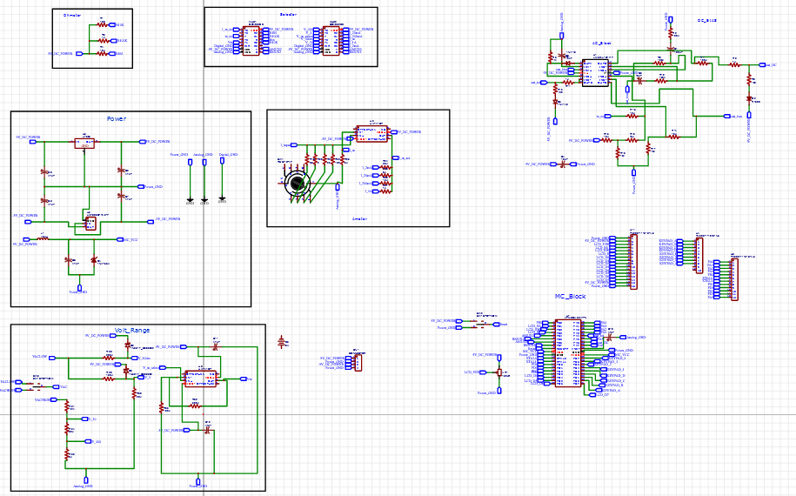
Schematic
05
22

Slide 23
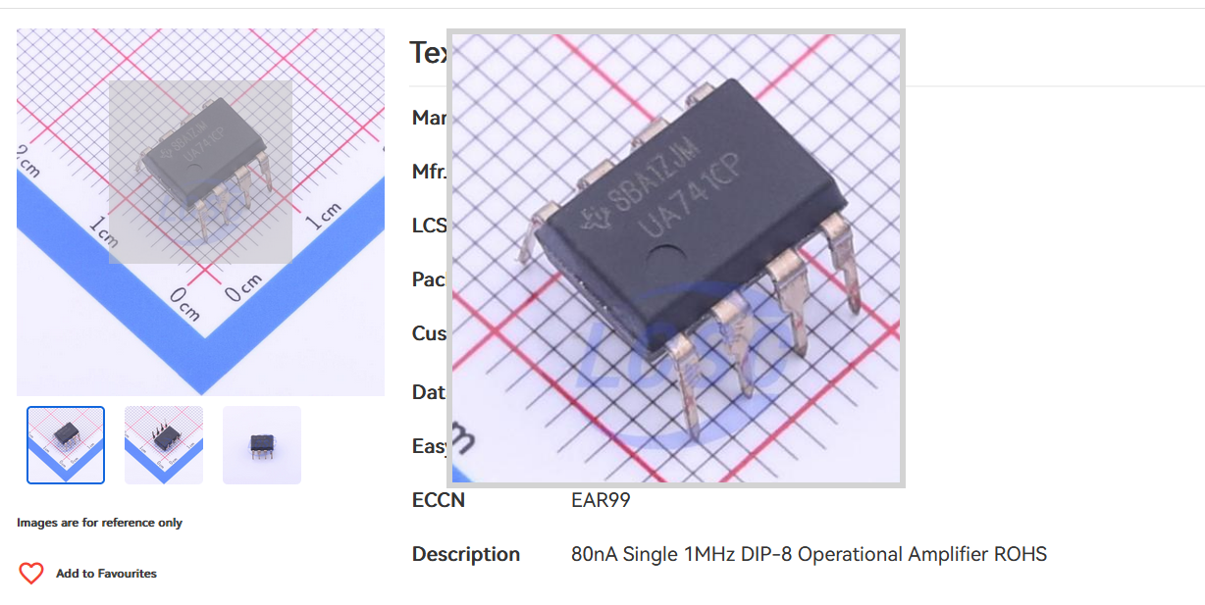
Foot Print
05
23

Slide 24
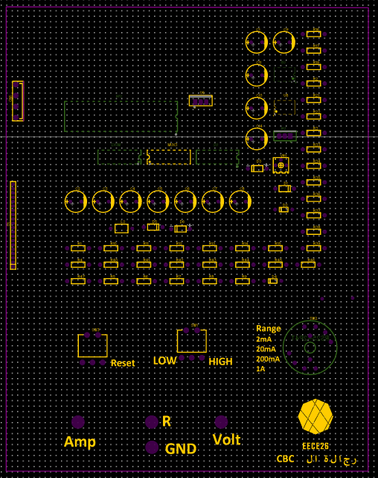
PCB Design
05
24

Slide 25
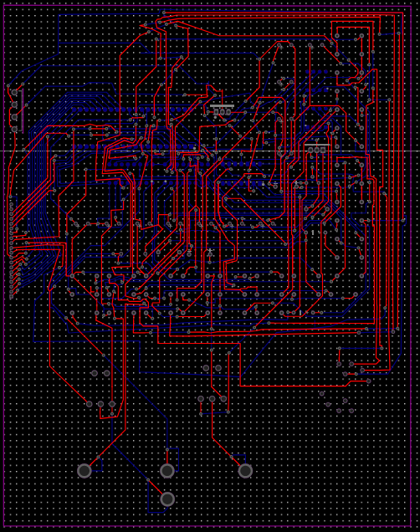
PCB Track
05
25

Slide 26
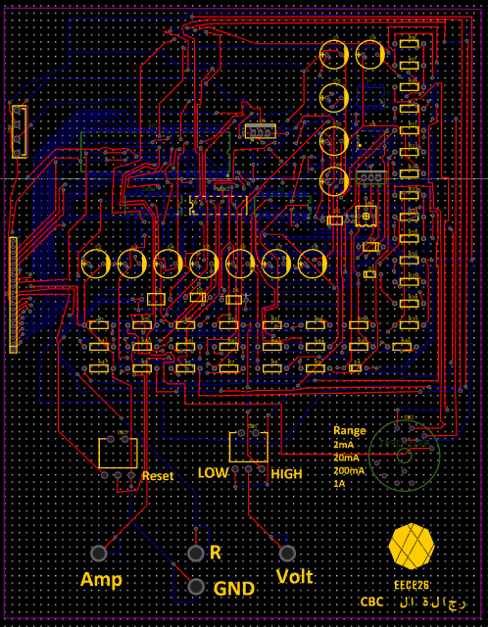
PCB Final
05
26

Slide 27
06
Conclusion & future work
27

Slide 28
Conclusion
06
DMM is important in many fields
It’s not easy to design
28

Slide 29
Future Work
06
Make More ranges
Provide a wattameter
29

Slide 30
any questions?
30

Slide 31
Thanks!
31

